Slide 1
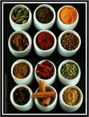
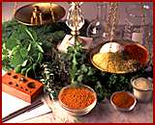
Some Like It Hot! Using Spices to Teach Inquiry

Slide 2
Uses of this information
Teach inquiry
Teach Scientific Method
Excite students about plants

Slide 3
Background
What are spices?
Plant products used to flavor food- May be leaves ( basil, oregano), branches (cinnamon), seeds, or roots
Long history of humans eating spices
Spices were first traded by the Arabs in 3000 BC
In 1453 BC the first Olympians in Greece celebrated victory wearing wreaths of bay and parsley.
Chile seeds, coriander found in Anazazi ruins in Southwest
Most cultures use spices, but tropical cultures use greater amounts and greater variety
Three theories
Hide taste of rotten food
Preserves food, inhibits spoilage
Acts as therapeutic

Slide 4
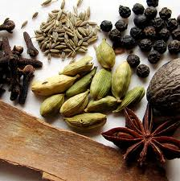
Extensions
Ethnobotany
Bio-prospecting
Antibiotic Resistance

Slide 5
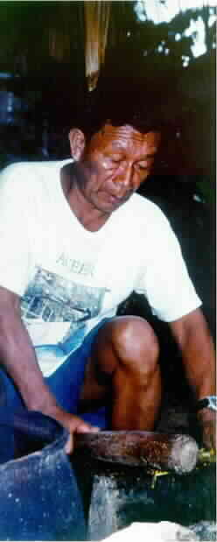
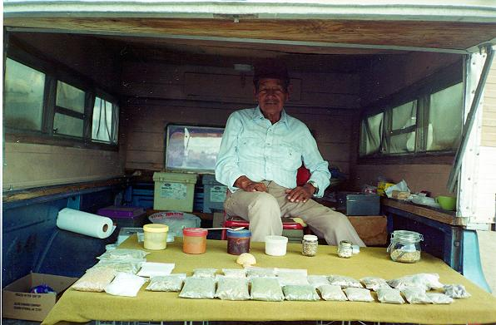
Ethnobotany- In many cultures, medicine men or shamans treat ill people with plants

Slide 6
Wormwood- Artemesia annua
Used by the Early Greeks to flavor wine
Glands that produce a chemical that deters insects (artemisinin)
Scientists think this chemical may protect against malaria

Slide 7
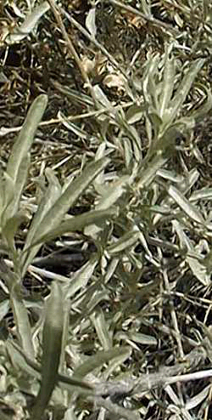
Chamisa is a very common plant in New Mexico
Used for treating stomach aches
Make a tea out of the flowers
Plant is related to camomille which many people today use as a tea for stomach aches

Slide 8
Spice Use Across the World
Scandanavia
Cloves
Cinnamon
Bay Leaves
Mexico
Cinnamon
Coriander
India
Cumin
Cinnamon
Coriander
Thailand
Cilantro/Coriander
Hot chiles

Slide 9
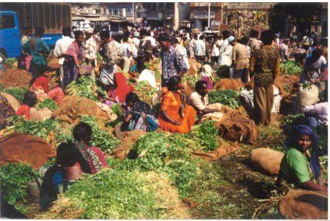
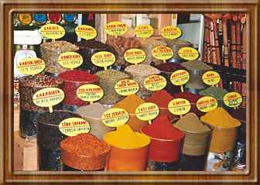

Slide 10
Navajo Traditional Therapies

Slide 11
Things to Think About
Who figured all of this out?
Were scientists involved?
Who knows all of this? Is it written down?
Do we use plants as medicines
How are medicines made from plants?

Slide 12
Are there other plants that are used as medicines?

Slide 13
Something to think about- How did humans figure out that plants could cure diseases?
Was it Trial and error?
Did They Watch Wild Animals?
Did People Die Trying New Medicines?
When did humans start
using plants as medicines?

Slide 14
Great for Inquiry and Scientific Method
Develop hypothesis
Design experiment
Controls?

Slide 15
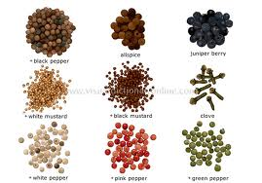
Materials and Supplies
Spices, Teas, Plants
Agar
Source of Bacteria
Pure cultures
Food
Environmental swabs

Slide 16
Methods
For whole spices
Pour thin layer of agar into petri dish and let solidify
Add 1-4 pieces of spice to agar
Pour more agar over spice-allow to harden
Cover spice totally with agar
For ground spices
Pour thin layer of agar into petri dish and let solidify
Sprinkle ground spice over ½ plate
Pour more agar over spice-allow to harden
Cover spice totally with agar

Slide 18
Safety Considerations
Do not use meat for source of bacteria
If use bacteria from student fingers, do not let students have open access to plates
In general, environmental and food ( non-meat and chicken) are safe

